Slide 1




Engagement Events
Continuing Healthcare and Section 117
JULY 2026
As a way of maximising the time today, and so we all have an equal voice, we encourage your participation in the following Mentimeter;
https://www.menti.com/alptr5hjg1cg
CODE 8700 6580

Slide 2
Victoria Hundleby
Programme Manager

Slide 3


Housekeeping
Approach to the session
Mobile phones
Breaks
Fire Alarm or IT considerations
Recording or Photographs
Mentimeter and FAQ

Slide 4
Event Tools
As a way of maximising the time today, and so we all have an equal voice, we encourage your participation in the following;
https://www.menti.com/alptr5hjg1cg
CODE 8700 6580

Slide 5
Agenda
Agenda Item | Further Detail | Events | LEAD
ARRIVAL Tea/Coffee
Welcome & Aims of the Event |  | BOTH | Victoria Hundleby, Programme Manager
Broadcare Patient Case Management System | Provider Portal and other changes | BOTH | Mollie Latham, Client Account Manager Nicola Trow, Operations Manager
Finance Team Update | Invoices and Scheduled Payments opportunity. | IN PERSON ONLY | Louise Tilley, Assistant Director of Financial Management
Continuing Healthcare Practice Development | Latest updates including 1-1 Protocol. | BOTH | Debbie Lee, Practice Development Lead
Section 117 Aftercare Transformation | Latest updates including upcoming discharges and provision gaps | VIRTUAL ONLY | Katie Robinson, S117 Transformation Lead
BREAK Tea/Coffee |  | IN PERSON ONLY
Adult Social Care Nursing | Latest changes in the team | BOTH | Sarah Fiori, Head of Adult Social Care Nursing (HNY ICB) / Principal Nurse (NYC)
North Yorkshire County Council | Shaping Care Programme | VIRTUAL ONLY | Hannah Brown, Commissioning & Provider Services Development Manager Service Development Team, Health and Adult Services
Hull City Council |  | BOTH | Chris Oakley, Service Development Commissioner (LD/MH)
FAQ for Panel |  | BOTH | Panel
Close

Slide 6
Actions from previous events
Key Contacts published
Share updates and activity – Website Traffic
System changes – Agenda
Share areas of opportunity – Agenda
S117 Transformation - Agenda
Joint working with 6 local authorities – Agenda
Payment Efficiencies - Agenda

Slide 7
Mollie Latham, Client Account Manager
Nicola Trow, Operations Manager

Slide 8

Market Engagement Event
NHS Humber and North Yorkshire ICB
July 2026
BroadCare Solutions | NHS Humber and North Yorkshire ICB | July 2026​

Slide 9
Agenda
Introduction to BroadCare Solutions
Current ICB/Marketplace challenges
Provider Portal
Q&A
BroadCare Solutions | NHS Humber and North Yorkshire ICB | July 2026​
Notes:
In this presentation we will do a quick introduction to us, BroadCare Solutions, We will then look at some key challenges that the ICB and the marketplace are currently facing with regards to brokering care for patients.
We will then run through a quick demonstration of our provider portal highlighting how the portal will help to alleviate the challenges
And then time permitting we will take any questions.

Slide 10


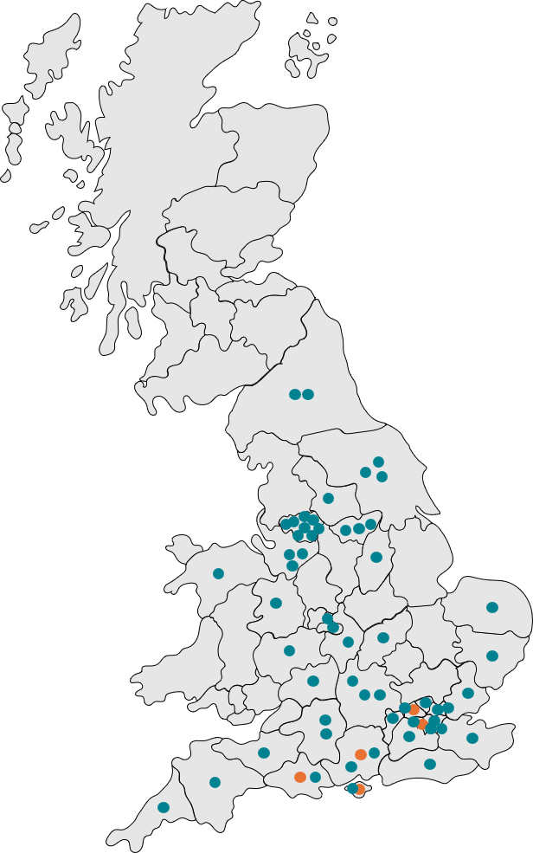



Who are BroadCare Solutions?
Market Leader
Our Presence
Market-leading software provider for NHS Continuing Healthcare (CHC) and All Age Continuing Care (AACC) and we work with over 70% ICBs in England
Financial Assured Managed Service
Software Provision
Specialists
Purpose-built for CHC and AACC system and services. Deep domain expertise NHS as well as providing excellent financial management services to identify cost-savings and pay providers promptly.
BroadCare Solutions is the market-leading software provider for NHS Continuing Healthcare (CHC) and All Age Continuing Care (AACC) and we work with over 70% ICBs in England.
Trusted
Through our Financial Assurance services, BroadCare Solutions produced savings of £7M against projected commissioned spend in a single financial year.
Long-standing relationships across NHS ICBs in England and Wales. The BroadCare suite is mature, reliable and secure.
End-to-End Platform
We provide an end-to-end digital platform covering referral, assessment, case management, provider brokerage, financial management and reporting — enabling NHS ICBs to deliver better, more efficient continuing care.
BroadCare Solutions | NHS Humber and North Yorkshire ICB | July 2026
Notes:
We’re proud to be the largest bespoke provider of AACC patient management systems in England and Wales, supporting over 70% of ICBs through our trusted platforms. With a 20-year track record, in delivering software and financial assurance managed services to the NHS,
Our systems help track patient journeys, from Referral to Financial management, mandatory and local reporting and everything in between
Our systems are used by thousands nationwide and in 2024 alone, 38000 referrals were submitted to ICB’s using our Digital Referral Portal.
We also offer a full financial assurance managed service to ICBs but I won’t go into that today.
If asked about FAMS - explain that we calculate the value of the commissioned care vs the actuals that we derive from our auditing process. These allow us to calculate the cost-avoidance figure by implementing the financial governance.
Do not read
explain that we calculate the value of the commissioned care vs the actuals that we derive from our auditing process. These allow us to calculate the cost-avoidance figure by implementing the financial governance.

Slide 11
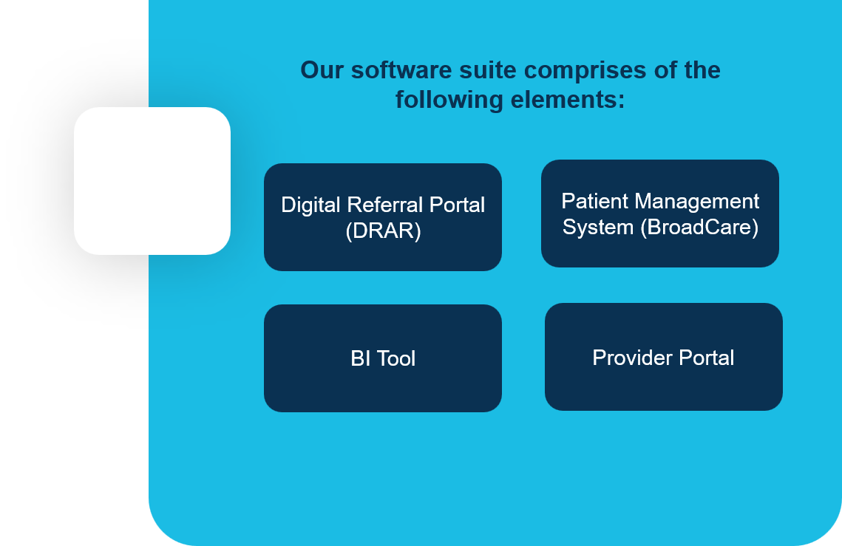
The BroadCare Software Suite
BroadCare Solutions work with Integrated Care Boards (ICBs) and Health Boards (HBs) to provide digital solutions to manage, track and report patient data.
Our software services enable you to:
Put robust and efficient data management processes in place within your organisation
Manage your data within a secure, hosted, bespoke solution catered to your needs
Reduce pressure on your teams by creating workflow and systemic efficiency gains
Leverage and report data on patient activity and organisational performance
Have access to a technical support team to resolve technical or operational queries
BroadCare Solutions | NHS Humber and North Yorkshire ICB | July 2026​
Notes:
Although today we will focus on our Provider Portal I just wanted to talk to the ICB and the marketplace about our full software suite
The suite comprises four key components.
First is the Digital Referral Portal which some providers may use in the future, this used to submit CHC and Fast Track referrals into the ICB in a digital format, negating the need for emails, as all information flows directly into BroadCare for the ICB to manage the full patient journey
Second is BroadCare, our core patient management system. This is where the patient record lives, and it supports the ICB with the entire patient journey,
Third is the Provider Portal featuring provider management and brokerage tools
Finally, our BI Tool provides the ICB with flexible reporting and insights to help with operational and strategic decision-making.
Together, the suite provides a secure, efficient end-to-end solution that streamlines patient management and improves data flow

Slide 12
Current ICB/Marketplace challenges
Receiving packages through the brokerage process.
Feedback when awarding/not awarding packages.
Prompt communication from the ICB
BroadCare Solutions | NHS Humber and North Yorkshire ICB | July 2026​
Notes:
Due to the 6 places, there have been inconsistencies. Human error with emails and managing lists of providers.
The marketplace would like want to know why they’ve not been successful to ensure success next time. The volume in terms of feedback is difficult for the ICB to manage
Marketplace would like prompt communication from the ICB

Slide 13
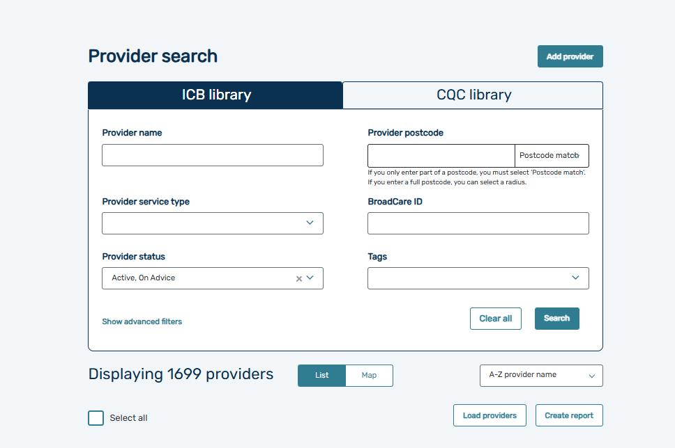
Provider Portal
The Provider Portal is an added module of BroadCare that integrates directly with the platform; the system is designed to communicate and manage providers effectively as well as brokerage care directly with providers.
Dedicated features include:
Manage a local list of providers integrated directly with CQC in real-time
Pull new/emerging providers directly from an integrated CQC library of providers
Manage contracts, safeguarding and more
Dedicated brokerage/dynamic procurement module to broker care more efficiency, governance and operational control
View and update bed availability
Providers can log in and respond to bids
Dedicated e-signature tool embedded to sign contracts and care agreements
BroadCare Solutions | NHS Dorset | July 2026​
Notes:
The Provider Portal is a digital solution that helps ICBs manage care providers with greater efficiency, transparency, and control.
The portal is fully integrated with BroadCare and syncs in real time with the CQC, giving ICBs a live view of local providers and their quality ratings.
At the heart of the system is a dynamic procurement module, enabling ICBs to digitallt issue placement requests and broker care directly with the marketplace.
Providers can log in and respond to bids and sign care agreements using in-built e-signature tools,
By digitising these workflows, the Provider Portal improves data quality, speeds up processes, and supports better commissioning outcomes.
And now I’ll move over to the provider portal for a demonstration

Slide 14
Any Questions
BroadCare Solutions | NHS Humber and North Yorkshire ICB | July 2026​

Slide 15
Louise Tilley,
Assistant Director of Financial Management
NHS Humber and North Yorkshire Integrated Care Board (ICB)

Slide 16
CHC Provider Payments
3 main routes for CHC provider payments:
Provider Invoice to the ICB (c16,000 individual invoices per year)
Schedule Payments/Self Billing
Local Authority
Challenges
ISFE 2
5 clinical databases
Staff turnover & reduced levels of staffing
Transition to the new system

Slide 17
On-going work
Short term
  Maximise the use of schedule payments/self billing
  Best practice invoice guide
    Upload via Tradeshift
    No patient name or NHS Number (invoices will be cancelled at source)
    Include the unique Broadcare/QA reference number
    No invoices in advance
    One package per invoice
    Monthly invoices where possible please
    Invoice for care provided (not default to IPA value)
Medium term
  Moving to 1 system across the ICB will allow the team to be merged, creating a more resilient service
  Allocation of staff by provider (not place)

Slide 18
Debbie Lee
Practice Development Lead

Slide 19
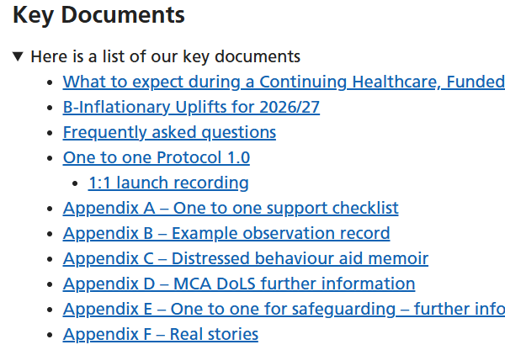
One-to-One Support Protocol Update
Protocol fully operational
Positive Outcomes and Learning from One-to-One Reviews
Improvements in quality of life and changes in practice
Examples of good practice identified through reviews

Slide 20
CHC Team Development and Training
We are aiming to improve the quality and consistency in CHC through targeted upskilling, enhanced practice, and stronger case presentation to providers when seeking care packages.
LD colleagues have delivered information sessions to CHC Assessors/Case Managers on Learning Disabilities including;
Positive Behaviour Support (PBS)
Communication
Health Inequalities
Medications
Further sessions are planned focusing on meaningful engagement and activities, helping assessors to identify opportunities for individuals to participate in activities that are purposeful, person-centred and outcome-focused.

Slide 21
Katie Robinson
S117 Transformation Lead

Slide 22
Workflow for Section 117
Looking at new process in line with new system- this process will align North Yorkshire/York and Humber case management process
Section 117 ICB in house policy- This is in final stages. This will need appendices adding in due course for the different Local Authorities.
Looking at cases coming through to case management from hospital placements that will require longer term care and support

Slide 23
Examples
Our case management team at the ICB provide 8 week oversight reviews for individuals who are under Transforming Care Framework. These individuals will often require longer term care and support when leaving hospital and will require case management.
The ICB also receive referrals from our provider collaborative colleagues for individuals who have been in long term locked rehabilitation and secure hospitals who may need ongoing care and support.
The ICB also receive regular referrals from the local acute wards for individuals requiring more longer term support

Slide 24
Opportunities
Section 117 transformation lead has gathered information from provider collaborative and our admission avoidance colleagues to establish what provisions will be required in the next 6-12 months
It is noted that there is a potential 5 individuals some with dementia who display sexually disinhibited behaviours or have a risk history against females who may require male only units
There is a lack of provision for individuals some of which have diagnosis of Autism/Learning Disabilities who have a forensic history and pose a risk to others
Lack of ABI specialist units within the community

Slide 25
Opportunities continued
There are only a small number of providers providing trauma informed care
There is a need for more Autism specialist providers, in particular, providing independent living. Although we are aware there is the provision our teams are finding that they are often full to capacity.

Slide 26
Sarah Fiori
Head of Adult Social Care Nursing
(HNY ICB) / Principal Nurse (NYC)
Tracey Sowersby,
Adult Social Care Nursing Team

Slide 27
Adult Social Care Nursing and Quality Team
https://humberandnorthyorkshire.icb.nhs.uk/adult-social-care-nursing-and-quality-team/

Slide 28
Hannah Brown
Commissioning & Provider Services Development Manager

Slide 29
Re-procurement of Care & Support Services
30th July 2026

Slide 30
Why We Are Re‑procuring Care and Support Services
Our current care and support contracts (APLs) end in November 2027
Current APL is a single contract that includes Care Homes; Supported Living; Home Based Support; Community Based Support
PIR identified lessons learnt and opportunities to improve/strengthen how we commission care and support
  Service Design
  Fee setting and structures
  Systems and processes
  Procurement and contracts
We want to ensure future contracts are fit for purpose, sustainable, and reflect how care is delivered today
The re‑procurement is an opportunity to:
  Strengthen partnership working with providers
  Support a diverse, resilient local care market
  Align contracts with the Care Act and future commissioning intentions
Our aim is to create a fair, transparent and sustainable framework for care and support services across North Yorkshire

Slide 31
Indicative Procurement Timeline
Jan – Sept ‘26
Provider engagement/ market testing
October ‘26-February ‘27
Finalise tender documents
NYC sign off/governance
*Spring/Summer ‘27
Tender period
Co-design of service specifications
Finalise contract
October ’26
Confirm plans for procurement and communicate to the market
*Autumn ‘27
Confirm plans for current APL contracts
Onboarding/ transition to new Contract
Review/modify internal systems and processes
Draft contract
Cost of Care exercise
New contract starts
*Staggered service-specific frameworks; timelines for tender & contract start date TBC:
Community Based Support Framework – Day Services, Support in the Community & Employment Support
Care Home Framework – Tiered Needs-Based Lots
Live Well at Home Framework – Community-Based Alliances
Supported Living Framework

Slide 32
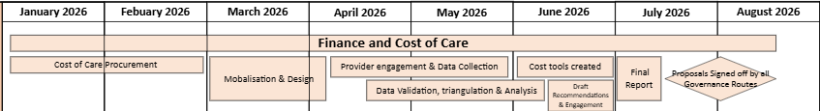
Cost of Care Exercise
Grant Thornton consultants have been commissioned to undertake the Cost of Care exercise to cover home based support, care homes (all age), supported living and day services
Purpose of the exercise is to:
  Inform fee structures and fee setting for the new contracts
  Inform our approach to affordability and sustainability
  Provide evidence to support our Care Act market‑shaping duties
Does not include:
    Out of county care homes/supported living
    Highly specialist services that support people with profound and multiple disabilities
    Community Based Support providers with a small market share
Deliverables include evidence-based cost of care rates; full report; costing tool to use for future fee setting/inflation conversations

Slide 33
Chris Oakley
Service Development Commissioner (LD/MH)

Slide 34
Complex Care Framework-
Hull City Council Market Engagement Update

Slide 35

Complex Care
The Hull City Council/ together with Humber and North Yorkshire ICB want to look at how we can better deliver servcies to people with complex care needs
Over the past 6 years we feel we have made some significant progress; however, we want to a build upon this with an ambitious new framework which will support the most complex individuals specifically for those on the Transforming Care programme/DSR or for those with significant health needs
We aim to develop a framework which is meets the current and upcoming challenges while also developing long term sustainability solutions for people.

Slide 36
Background & Context
Over the last few years, we have seen increasing numbers of people requiring high cost and complex packages of care
This is partly a result of the increasing complexity of people being discharged into the community from hospital provision both the acute setting psychiatric setting as well as prison.
We are also seeing more requirement for complex care provision when young people reach 18
The complexity of these people and the specialist skills needed to meet their needs means that providers are not able or willing to provide services within the existing contracts
The lack of suitable accommodation from the Council’s own housing stock has resulted on an overreliance on the private sector

Slide 37
Identified Barriers and Issues
Not enough Supply within the Markert
Not enough appropriate housing / environment
Financial sustainability for all parties
Development is sporadic and difficult to keep up with demand
Lack of Investment into specialist supported housing - Providers need to have assurances that they will be a return on their investment.
Lack of complex respite is causing an issue and family carer breakdown means the Authority are having to find full time care arrangements sooner than anticipated
Lack of community crisis intervention is causing more people to end up in inpatient setting – this goes against the new proposed amendments of the Mental Health Act
Good practice guidelines challenges economics of scale – Right Care, Right Support, Right Culture

Slide 38
What are we currently doing?
Complex Care tracker – Managed by ASC Senior management
Complex Transitions meeting and collaborative working between Children's and Adults Social care Team
Market Development of supported living services in Hull
Harbour Project – using NHSE Capital grant
Internal Housing group – Explore the development of internal capital developments
Residential Respite Project group - looking at all options not just building based options i.e.. shared lives / family in-reach / short breaks

Slide 39
What do we want to achieve today and beyond?
Maintain highest standard quality of provision
Engage with suppliers – ensure compliance
Ensure Hull City Council are compliant with procurement legislation
Looking to work with Partners not Providers
Remove the need for spot purchasing in this area
Bring providers to the table and unlock investment in capital and infostructure
Create a sustainable and affordable provision for both Hull City Council/ICB and providers

Slide 40
Development of integrated complex care framework which brings Adult Servcies, Children’s, Housing , ICB and providers together to support the development of complex care and support provision in Hull
The Framework will have a selected number of providers – with opportunity to open to other providers during the lifetime of the contract on the Authority's discretion Maintain highest standard quality of provision
Multiple Lots (pathways) for different needs/provisions Opportunity to commission one or groups of individuals at one time – economies of scale
Will work with specialist providers to ensure we can meet demand over the next 10 years
Explore opportunities for development of new services and reconfigure existing services
Capital Investment – mixture of Private, exploring HCC stock or joint funding bids
Opportunity to explore new technologies and AI innovation to improve people’s independence
Possibility to work with our neighbours in East Riding and wider ICB footprint.

Slide 41
Complex Carer Framework
The Complex Care Framework will work with a small number of specialist providers on each Pathway that can support people with complex healthcare and social care support needs
Pathway 1: Supported Living +
  Provides complex based accommodation support within core and cluster model and replaces the old TCP regional framework
Pathway 2: Complex Community Healthcare (16+)
  Provides enhanced community-based support to individuals with high complex physical and cognitive support needs (usually have health contribution via Continuing Healthcare)
Pathway 3: Transitions Support (16 to 24 ) Ofsted and CQC regulated servcies
  Tier: 1: Support to Independent Living - for young people to develop their independence skills so they can move onto independent living _Likely to be supported living
  Tier 2: Complex - For young people (16++) who require complex Care and accommodation - consideration to be given to small residential units as well as Supported Living model.
Pathway 4: Respite and Short Stay
  Will provide complex Respite, step down and crisis intervention to keep families together and support dentation under Mental health Act
  Will need to be small complex residential settings with robust environment

Slide 42
Pathway 1
Provides enhanced accommodation-based support for people with high complex needs (TCP / Continuing Healthcare)
Primary Support Need will be Learning Disability/Autism, Physical Health needs
Will support move from family home or discharge from inpatient and forensic settings
Will allow us to commission groups of people so providers can develop core and Cluster models and reduce the need on overly restrictive packages in single service dwellings (dispersed properties should be last option and only in unique circumstances)
Affordability and sustainable for all

Slide 43
Pathway 2
Provides enhanced community-based support to individuals with high complex physical , Mental and/or and cognitive support needs (will likely have health funded contribution via Continuing Healthcare or s117)
Would like to support long-term and short-term community packages
Opportunities to mobilise emergency packages both within the home or support existing providers as part of a wrap around service
Reduces sport purchased across the system
Opportunities for smaller packages to be commissioned through economics of scale
Would like to explore 16+ provision to support transition

Slide 44
Pathway 3
CQC and Ofsted registered providers to provide a range of transition accommodation based servcies to support independence into adulthood (these could be a mixture of supported living or residential)
Tarif: 1: Support to Independent Living
  For young people to develop their independence skills so they can move onto independent living
  Low to Medium level Care/Support needs but maybe complex in other areas i.e. Mental Health, Forensic, Criminal Justice, Care Leavers
  Support is naturing and provides guidance while allowing young people to mature into adulthood at their own pace
  We want to create a culture where young people can aspire to be their best versions of themselves
Tarif 2: Complex
  For people who require complex care and accommodation and will always need a high level of support to help to live their life.
  Refer to pathway 1 for type of support required

Slide 45
Pathway 4
The pathway aims to support people with complex care and support needs to remain in the family home.
The pathway will also support to address the issue around people with Learning Disabilities and/or Autistic people being inappropriately detained under the Mental Health Act (1983)
Respite: Support people with complex care needs to access regular complex care respite
Step Down: opportunities for people with complex case need to step down from inpatient while we commission their long-term care and support (Pathway 1)
Criss Intervention: To support people with complex care due to family or placement breakdown
For Respite and Crisis Intervention there will be consideration for block booking .
Can procure providers onto framework so they are primed for developing servcies and when we require as directed by the Local Authority
These will likely need to be residential placements as tenancies become problematic for short term provision

Slide 46
Additional Information
Each Pathway will have a maximum number of providers for ‘Call off,’ to avoid oversaturation within the market
Providers will need to demonstrate their passion, commitment expertise withn the complex care sector
This will include a commitment to provide enhanced wages, training and an infrastructure which support the delivery of complex care
Priority will be given to providers who can demonstrate the ability to be innovative and reduce the overall need on direct staff delivery such as the use of environment, Assistive Technology and AI.
Providers, will be encouraged to work in partnership to support the overall aims and objectives of the Complex Care service - examples could include, sharing of training, resources, staff support .

Slide 47
Pricing
Pricing schedule is still to be finalised but likely to vary from each pathway to represent the specific servcies
The Pricing Schedule will reflect providers commitment to provide enhanced payments to staff and level of enhanced expert training they will receive alongside a robust support infostructure for high quality delivery of complex care
However, Providers need to demonstrate Value for Money which includes:
  Dynamic Pricing for packages for duration or multiple staffing of packages/placements e.g. - hourly compared to half day compared full day compared to weekly fee and/or cost of one member of staff compared to 2 or 3 members of staff
  Use of Assistive Technology and Artificial Intelligence to reduce one to one
  Providers working together to reduce their costs i.e. training ,recruitment costs etc

Slide 48
Consultation
Experience of providing similar services
Are you currently providing services similar to the current authority services to any public authority or private sector customer? If so, please describe the key features of those contracts, including:
  The contract duration and value.
  Whether any transformation of the services was required and, if so, the nature of the transformation and the timescale for implementation.
  What approach are your other areas taking to sourcing these sorts of services?
  What, in your view, are the strengths and weaknesses of this approach
  What issues arose on transition or transformation of those services, and how were they addressed?

Slide 49

Key Messages to leave you with….
Complex Care Support
Building on what is already in place within Hull
We want to work with partners committed and motivated to work with us to develop the best programme we can……
More than a contractual relationship

Slide 50

The Procurement Process
Tenders sought using the open tender procedure in accordance with Procurement Act 2023.
Suppliers must be registered to YORtender
Register at https://uk.eu-supply.com
All tender documentation & information will be published via YORtender.
The tender consists:
Services Agreement
Specification

Slide 51

Contract and Pricing
To award a contract for an initial 5-year period. The contractual period shall commence on 1st January 2028 and end on 31st December 2032 (subject to annual funding being agreed) with an option to extend for a further 5-year periods.
The anticipated value of the Services is yet to be determined, but focus will be on low volume high-cost complex placements
The weighting score for evaluation of tenders shall be detailed within the tender documents. (Quality/Price)

Slide 52

Updated Anticipated Timescales
ITT will be advertised on YORtender: April/May 2027 TBC
Potential submission deadline: July 2027
Tender Evaluation: September – August 2027
(Potential) Negotiation Period – September 2027
Authority’s Decision-Making Process – November
Contract Award(s): December 2027
Service Commencement: 1st January 2028
A more detailed anticipated timescale will be published within the ITT Part 1.

Slide 53

Thank you…… & Any Questions?

Slide 54
Denise Nightingale
Director of Nursing
Complex Care

Slide 55
Mentimeter
1) Feedback to share with the ICB.
2) What questions do you have for the ICB?
3) How is the payment process working?
https://www.menti.com/alptr5hjg1cg
CODE 8700 6580

Slide 56
Questions to the Panel

Slide 57
A big thank you for attending today and contributing to the market engagement events.

Slide 58
End of Slides

